Slide 1






Applied Data Science Capstone
1
A Praveen
3rd June 2024

Slide 2
Outline
Executive Summary
Introduction
Methodology
Results
Conclusion
Appendix

Slide 3
Executive Summary
Summary of methodologies
Data Collection through API
Data Collection with Web Scraping
Data Wrangling
Exploratory Data Analysis with SQL
Exploratory Data Analysis with Data Visualization
Interactive Visual Analytics with Folium
Machine Learning Prediction
Summary of all results
Exploratory Data Analysis result
Interactive analytics in screenshots
Predictive Analytics result

Slide 4
Introduction
Project background and context
Space X advertises Falcon 9 rocket launches on its website with a cost of 62 million dollars; other providers cost upward of 165 million dollars each, much of the savings is because Space X can reuse the first stage. Therefore, if we can determine if the first stage will land, we can determine the cost of a launch. This information can be used if an alternate company wants to bid against space X for a rocket launch. This goal of the project is to create a machine learning pipeline to predict if the first stage will land successfully.
Problems you want to find answers
What factors determine if the rocket will land successfully?
The interaction amongst various features that determine the success rate of a successful landing.
What operating conditions needs to be in place to ensure a successful landing program.

Slide 5
M E T H O D O L O G Y
Section 1

Slide 6
Methodology
Executive Summary
Data collection methodology:
Data was collected using SpaceX API and web scraping from Wikipedia.
Perform data wrangling
One-hot encoding was applied to categorical features
Perform exploratory data analysis (EDA) using visualization and SQL
Perform interactive visual analytics using Folium and Plotly Dash
Perform predictive analysis using classification models
How to build, tune, evaluate classification models

Slide 7
Data Collection
The data was collected using various methods
Data collection was done using get request to the SpaceX API.
Next, we decoded the response content as a Json using .json() function call and turn it into a pandas dataframe using .json_normalize().
We then cleaned the data, checked for missing values and fill in missing values where necessary.
In addition, we performed web scraping from Wikipedia for Falcon 9 launch records with BeautifulSoup.
The objective was to extract the launch records as HTML table, parse the table and convert it to a pandas dataframe for future analysis.

Slide 8
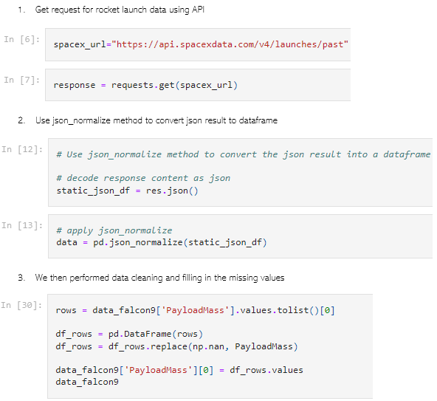
Data Collection – SpaceX API
We used the get request to the SpaceX API to collect data, clean the requested data and did some basic data wrangling and formatting.
The link to the notebook is
https://github.com/Praveen-Anil/Data-Science/tree/main/Data%20Science%20Final

Slide 9
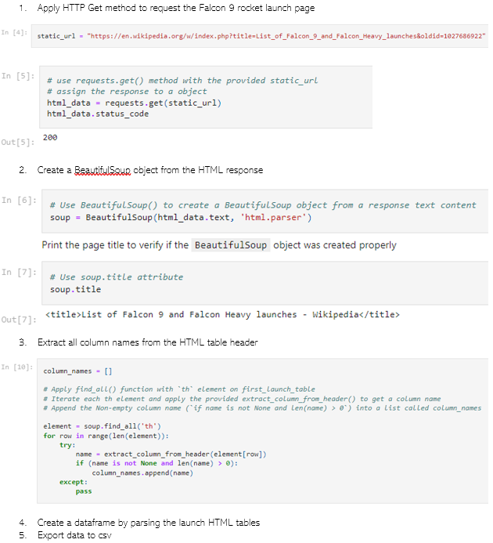
9
Data Collection - Scraping
We applied web scrapping to webscrap Falcon 9 launch records with BeautifulSoup
We parsed the table and converted it into a pandas dataframe.
The link to the notebook is
https://github.com/Praveen-Anil/Data-Science/tree/main/Data%20Science%20Final
9

Slide 10
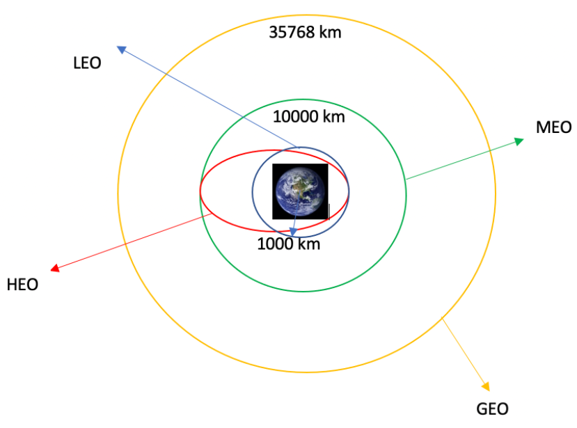
Data Wrangling
We performed exploratory data analysis and determined the training labels.
We calculated the number of launches at each site, and the number and occurrence of each orbits
We created landing outcome label from outcome column and exported the results to csv.
The link to the notebook is https://github.com/Praveen-Anil/Data-Science/tree/main/Data%20Science%20Final

Slide 11
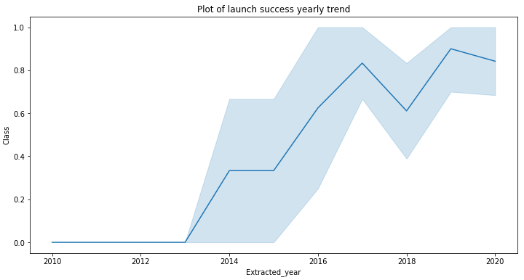
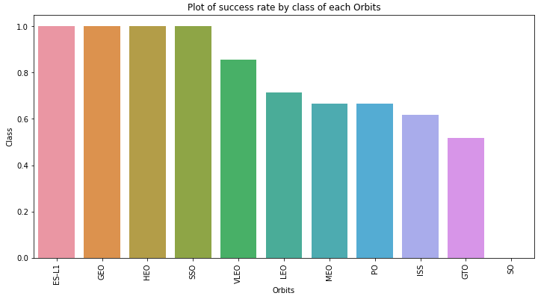
EDA with Data Visualization
11
We explored the data by visualizing the relationship between flight number and launch Site, payload and launch site, success rate of each orbit type, flight number and orbit type, the launch success yearly trend.
The link to the notebook is https://github.com/Praveen-Anil/Data-Science/tree/main/Data%20Science%20Final

Slide 12
EDA with SQL
We loaded the SpaceX dataset into a PostgreSQL database without leaving the jupyter notebook.
We applied EDA with SQL to get insight from the data. We wrote queries to find out for instance:
The names of unique launch sites in the space mission.
The total payload mass carried by boosters launched by NASA (CRS)
The average payload mass carried by booster version F9 v1.1
The total number of successful and failure mission outcomes
The failed landing outcomes in drone ship, their booster version and launch site names.
The link to the notebook is https://github.com/Praveen-Anil/Data-Science/tree/main/Data%20Science%20Final

Slide 13
Build an Interactive Map with Folium
We marked all launch sites, and added map objects such as markers, circles, lines to mark the success or failure of launches for each site on the folium map.
We assigned the feature launch outcomes (failure or success) to class 0 and 1.i.e., 0 for failure, and 1 for success.
Using the color-labeled marker clusters, we identified which launch sites have relatively high success rate.
We calculated the distances between a launch site to its proximities. We answered some question for instance:
Are launch sites near railways, highways and coastlines.
Do launch sites keep certain distance away from cities.

Slide 14
Build a Dashboard with Plotly Dash
We built an interactive dashboard with Plotly dash
We plotted pie charts showing the total launches by a certain sites
We plotted scatter graph showing the relationship with Outcome and Payload Mass (Kg) for the different booster version.
The link to the notebook is
https://github.com/Praveen-Anil/Data-Science/blob/main/Data%20Science%20Final/app.py

Slide 15
Predictive Analysis (Classification)
We loaded the data using numpy and pandas, transformed the data, split our data into training and testing.
We built different machine learning models and tune different hyperparameters using GridSearchCV.
We used accuracy as the metric for our model, improved the model using feature engineering and algorithm tuning.
We found the best performing classification model.
The link to the notebook is https://github.com/Praveen-Anil/Data-Science/tree/main/Data%20Science%20Final

Slide 16
Results
Exploratory data analysis results
Interactive analytics demo in screenshots
Predictive analysis results

Slide 17
Section 2
INSIGHTS DRAWN FROM EDA

Slide 18
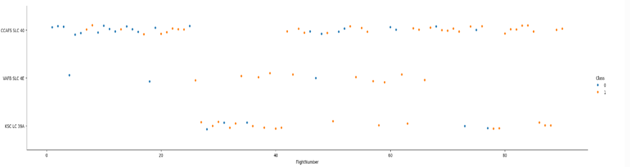
Flight Number vs. Launch Site
Blue = failure , orange = success

Slide 19
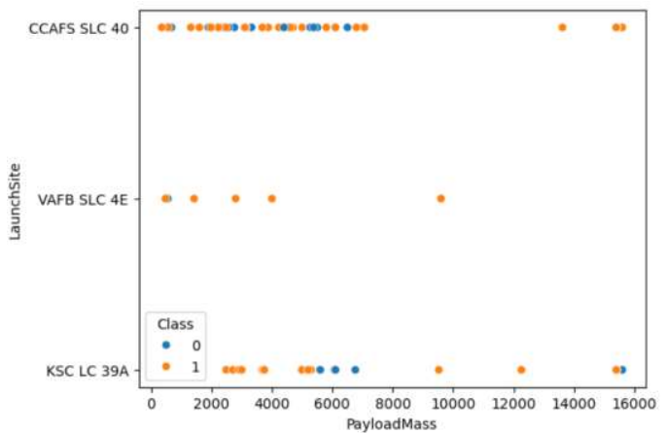
Payload vs. Launch Site
Blue = failure , orange = success

Slide 20
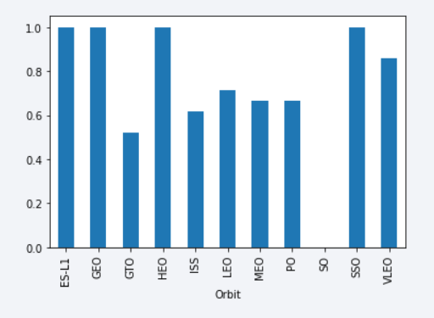
Success Rate vs. Orbit Type
The biggest success rates happens to orbits ES-L1 ,GEO ,HEO and SSO

Slide 21
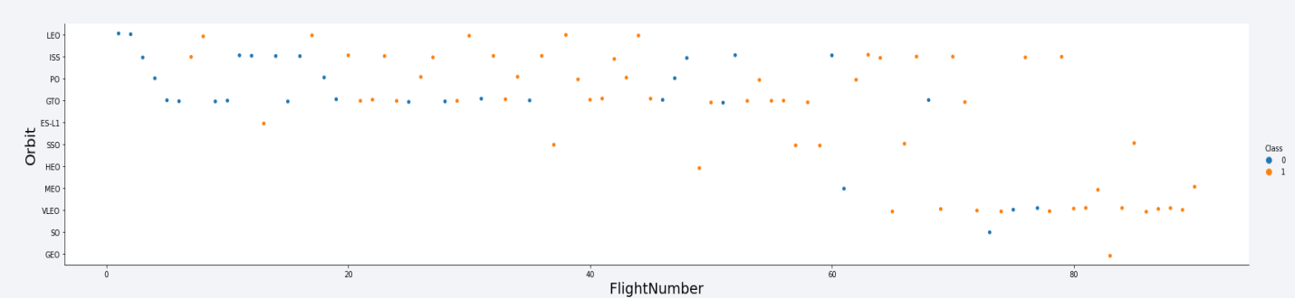
Flight Number vs. Orbit Type
Looks like the success rate improved over time to all orbits

Slide 22
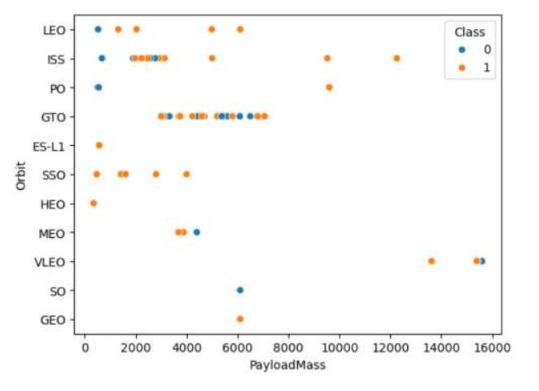
Payload vs. Orbit Type
No relation between payload and success rate to orbit GTO
VLO High payloadmass

Slide 23
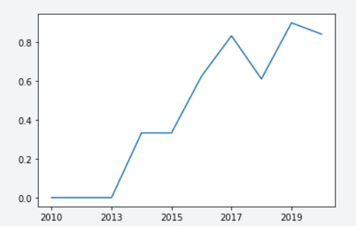
Launch Success Yearly Trend
Success rate increase 2013 and keep until 2020.

Slide 24

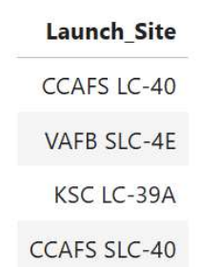
All Launch Site Names
SQL Query:
Results:

Slide 25
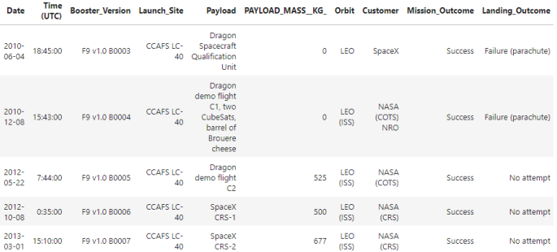
Launch Site Names Begin with 'CCA'
SQL Query:
Results:

Slide 26
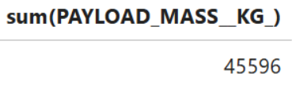
Total Payload Mass
SQL Query:
Results:

Slide 27
Average Payload Mass by F9 v1.1
SQL Query:
Results:

Slide 28
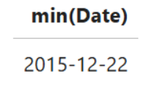
First Successful Ground Landing Date
SQL Query:
Results:

Slide 29
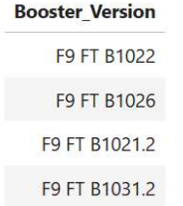
Successful Drone Ship Landing with Payload between 4000 and 6000
SQL Query: %sql
Results:

Slide 30
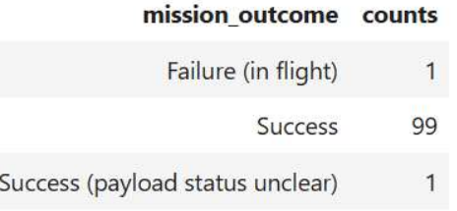
Total Number of Successful and Failure Mission Outcomes
SQL Query:
Results:

Slide 31
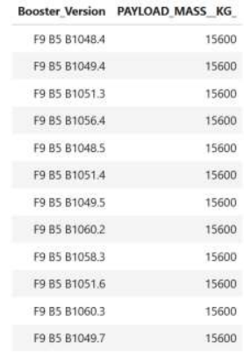
Boosters Carried Maximum Payload
SQL Query:
Results:

Slide 32
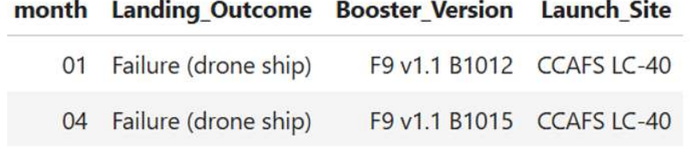
2015 Launch Records
Results:

Slide 33
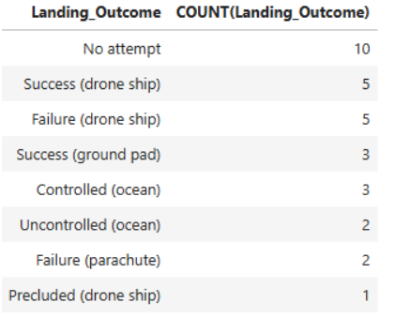
Rank Landing Outcomes Between 2010-06-04 and 2017-03-20
SQL Query:
Results:

Slide 34
Section 3
LAUNCH SITES PROXIMITIES ANALYSIS

Slide 35
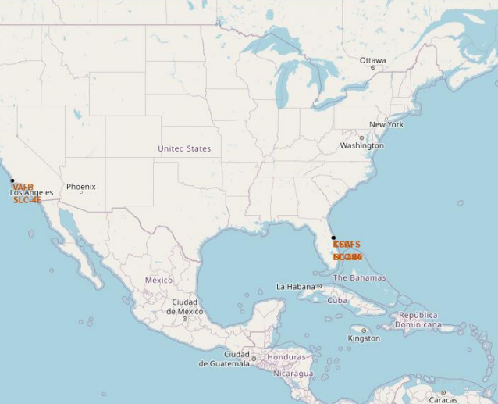
Folium Map 1
Sites are near the sea and close to roads and railroad.

Slide 36
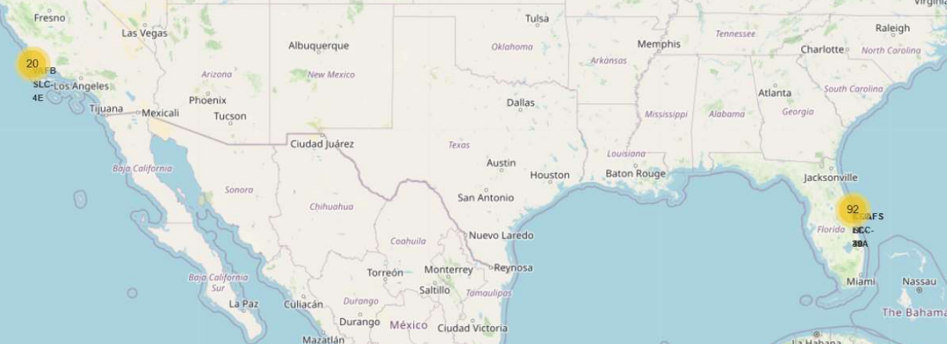
Folium Map 2
The numbers show launches in these areas. You can zoom in the map to see exactly where they happened.

Slide 37
Section 4
BUILD A DASHBOARD WITH PLOTLY DASH

Slide 38
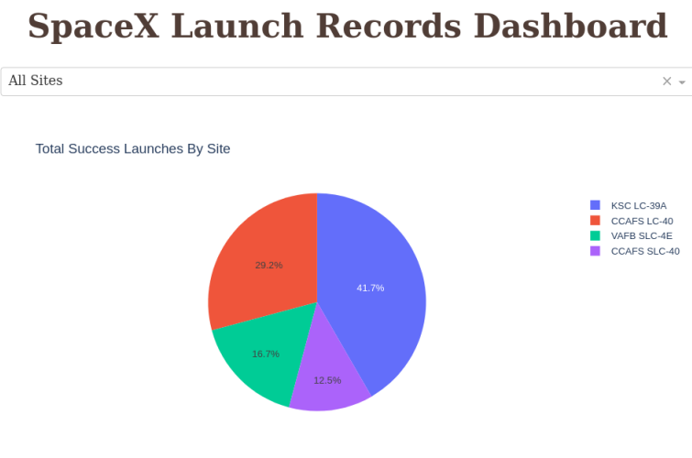
Dashboard 1
KSC LC 39-A has the biggest success rate.

Slide 39
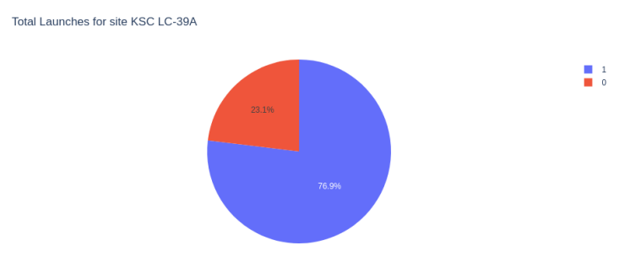
Dashboard 2
The success rate for this launchsite was 76%

Slide 40
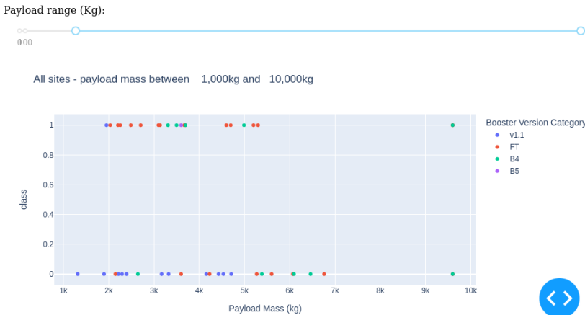
Dashboard 3
Payloads < 6 000kg & FT boosters are the best.

Slide 41
Section 5
PREDICTIVE ANALYSIS (CLASSIFICATION)

Slide 42
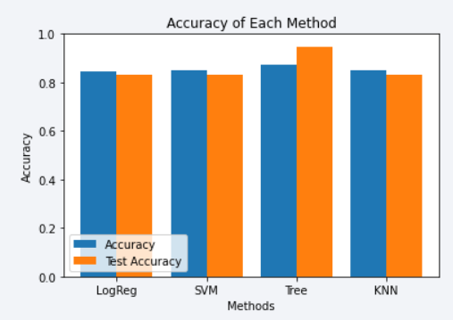
Classification Accuracy
Decision Tree Classifier has the highest classification accuracy.

Slide 43
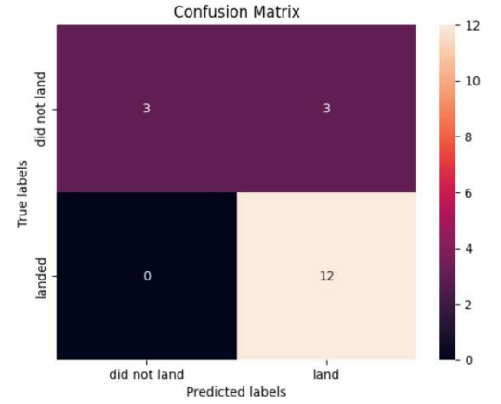
Confusion Matrix
Show the confusion matrix of the best performing.

Slide 44
Conclusions
We can conclude that:
The larger the flight amount at a launch site, the greater the success rate at a launch site.
Launch success rate started to increase in 2013 till 2020.
Orbits ES-L1, GEO, HEO, SSO, VLEO had the most success rate.
KSC LC-39A had the most successful launches of any sites.
The Decision tree classifier is the best machine learning algorithm for this task.

Slide 45
Thank You

